Slide 1
2023
EXECUTIVE
BEN
Global Forum

Slide 2
2019

Slide 3
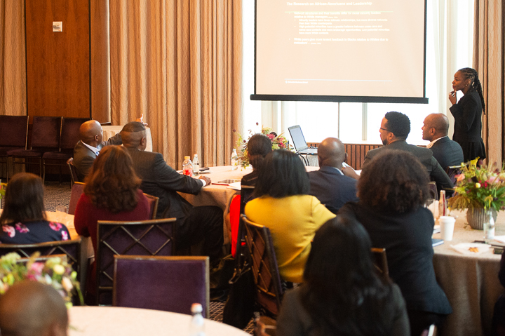
2019

Slide 4
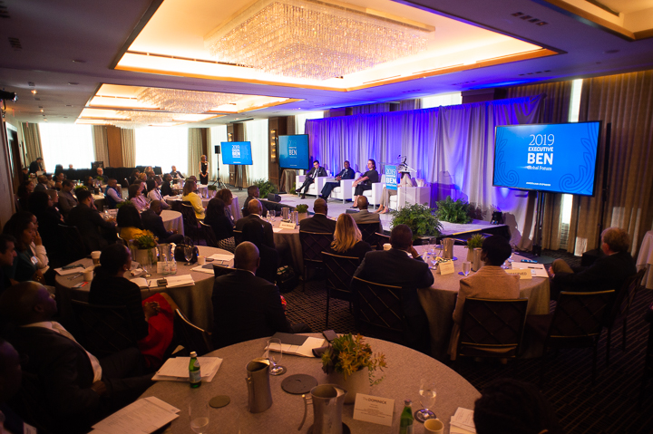
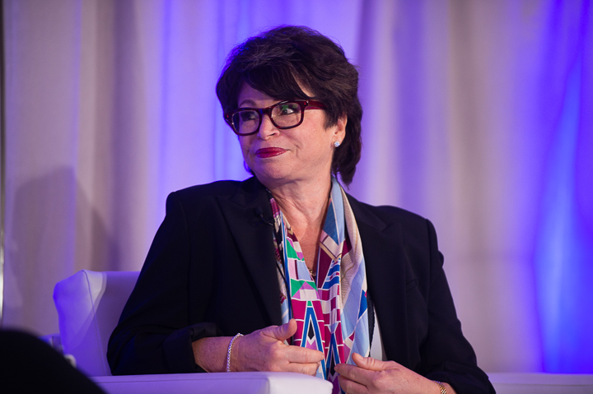
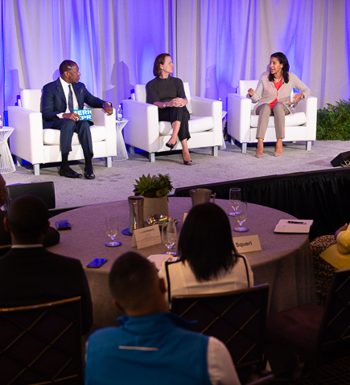
2019

Slide 5
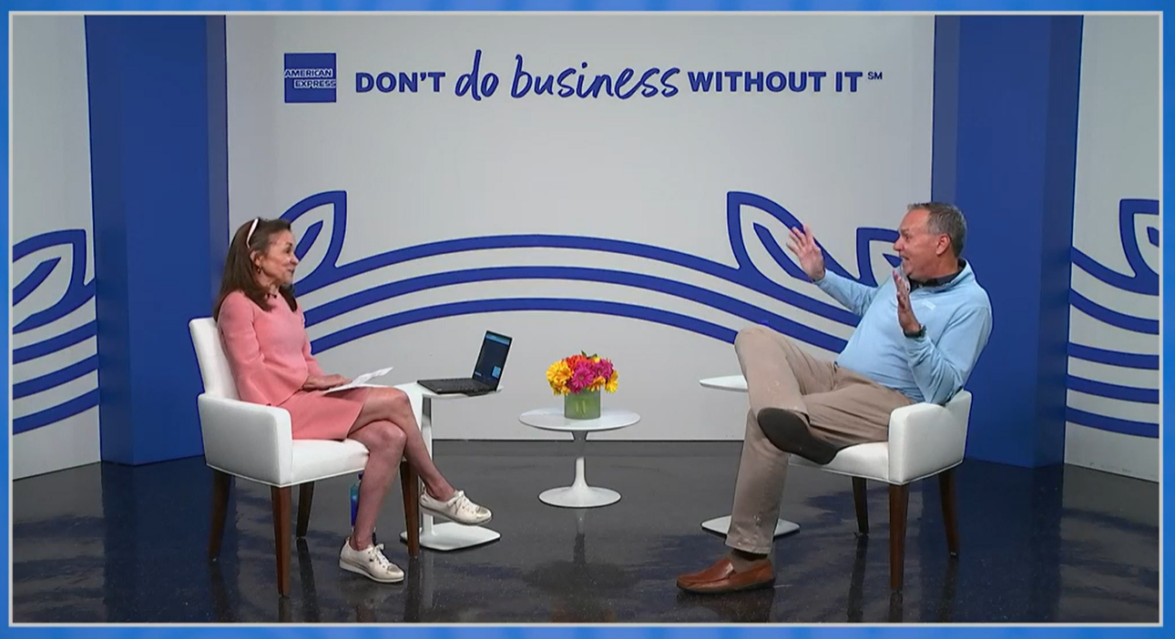
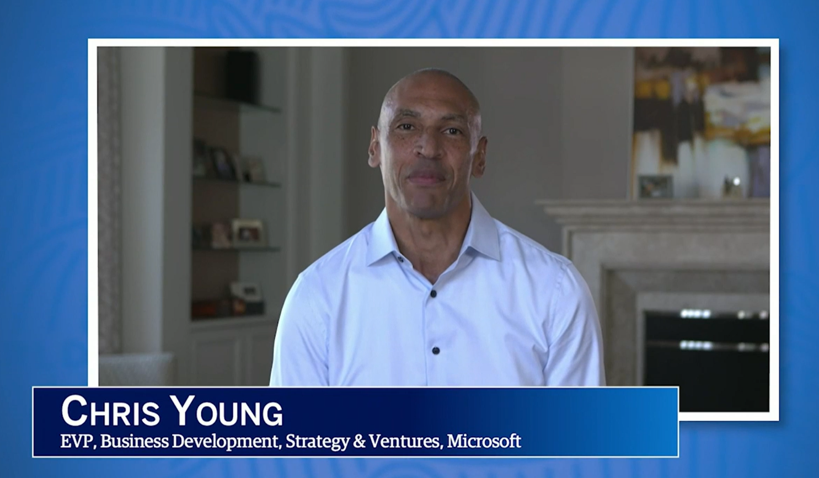
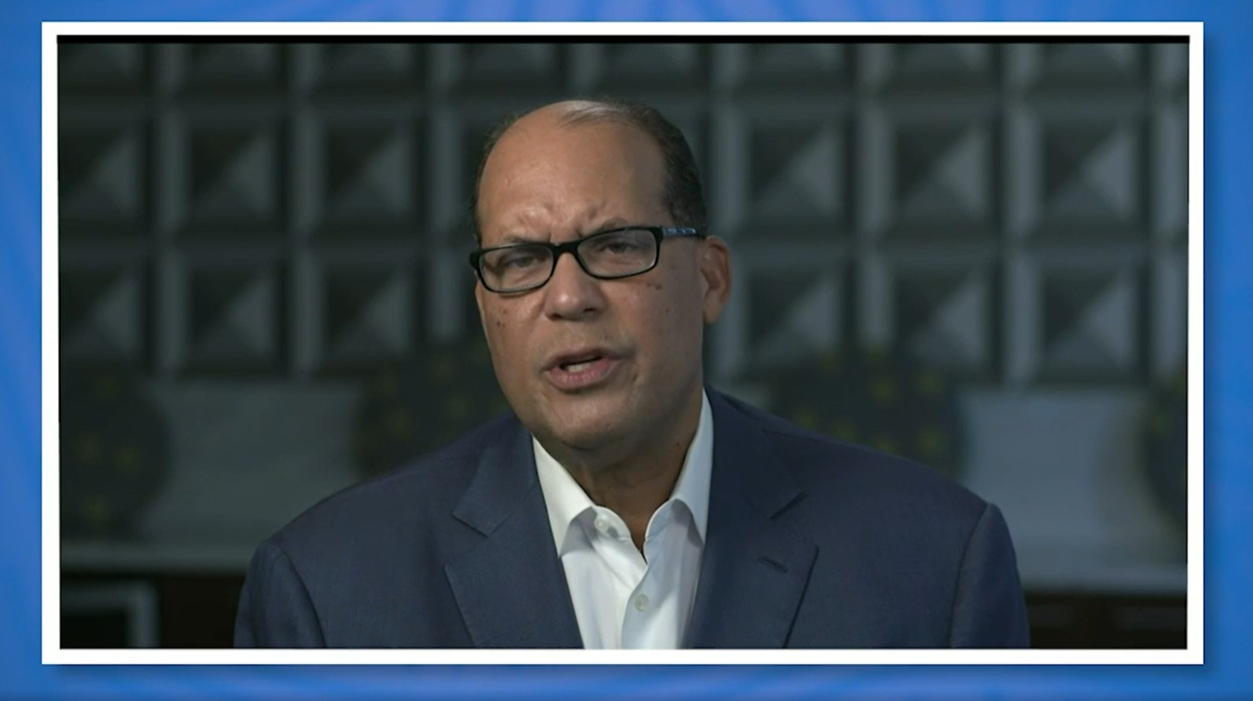
2021

Slide 6
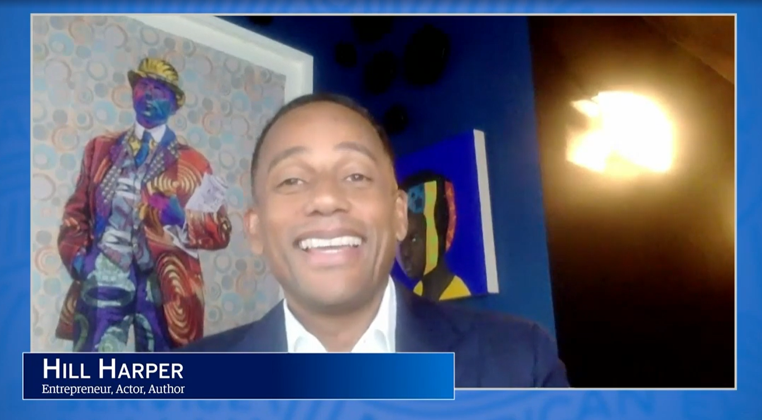
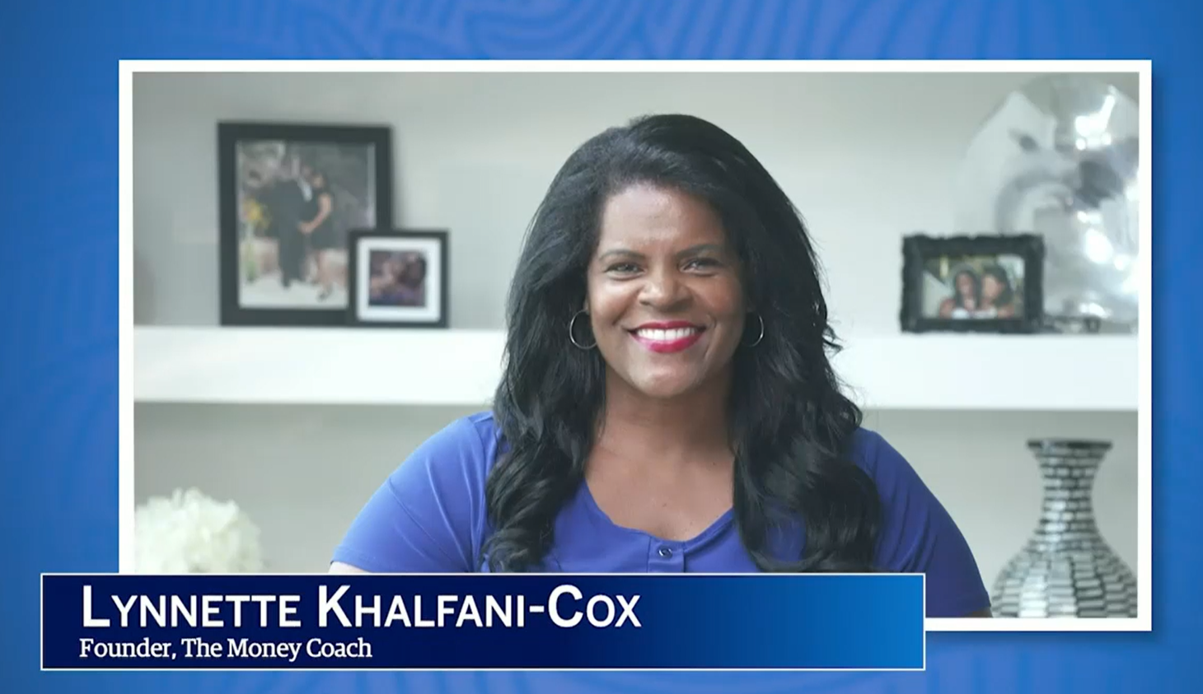
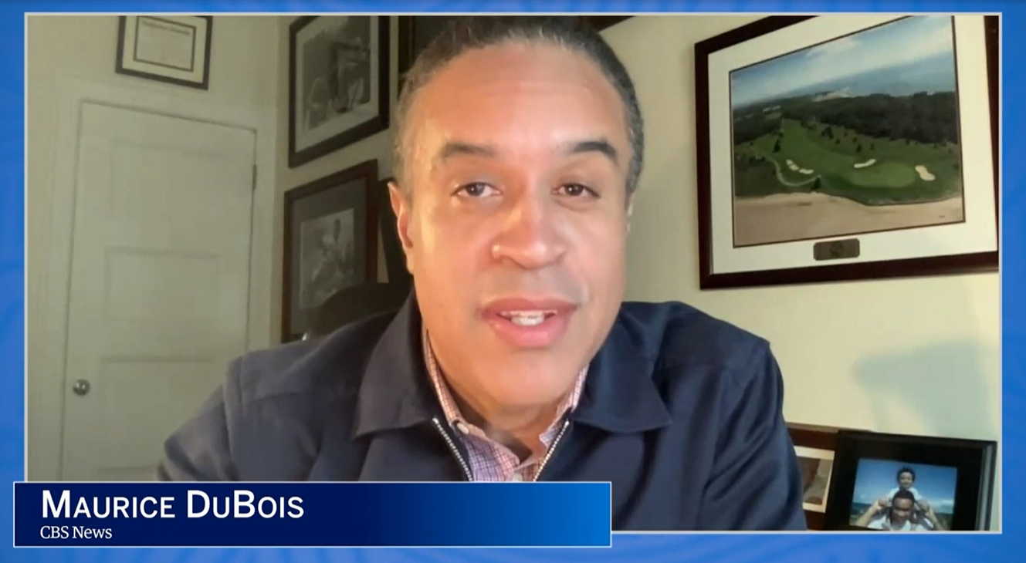
2021

Slide 7
2023
EXECUTIVE
BEN
Global Forum

Slide 8
FIRESIDE CHAT
STEVE SQUERI
Chairman and Chief Executive Officer
SHURAWL SIBBLIES
Executive Vice President, Colleague Strategic Partner
Colleague Experience Group

Slide 9
2023
EXECUTIVE
BEN
Global Forum

Slide 10
WORKSHOP
INTRODUCTION
Leading with Authenticity Room 1
We are the Champions: Being a Sponsor & Seeking Sponsorship Room 8
Leading through Change: Resiliency Room 9

Slide 11
NETWORKING BREAK
2023
EXECUTIVE
BEN
Global Forum
3:00 - 3:25 PM

Slide 12
2023
EXECUTIVE
BEN
Global Forum

Slide 13
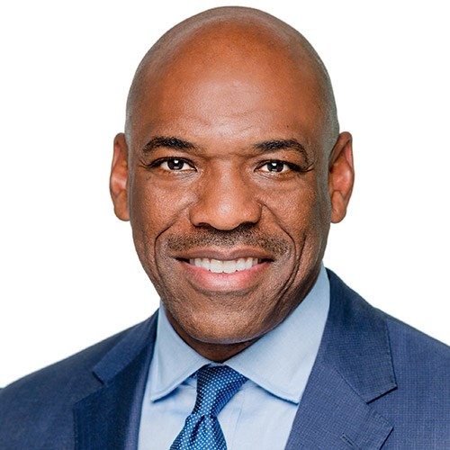
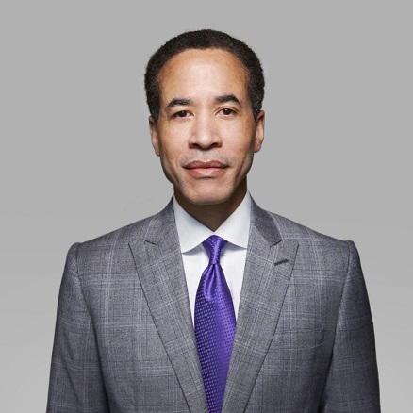
FIRESIDE CHAT
CHARLES PHILLIPS
Managing Partner, Co-founder RECOGNIZE
ANRÉ WILLIAMS
Chief Executive Officer, American Express National Bank, and Group President, Enterprise Services

Slide 14
2023
EXECUTIVE
BEN
Global Forum

Slide 15
DINNER
RECEPTION
PLEASE MEET IN THE LOBBY OF THE VESEY STREET ENTRANCE

Slide 16
2023
EXECUTIVE
BEN
Global Forum

Slide 17
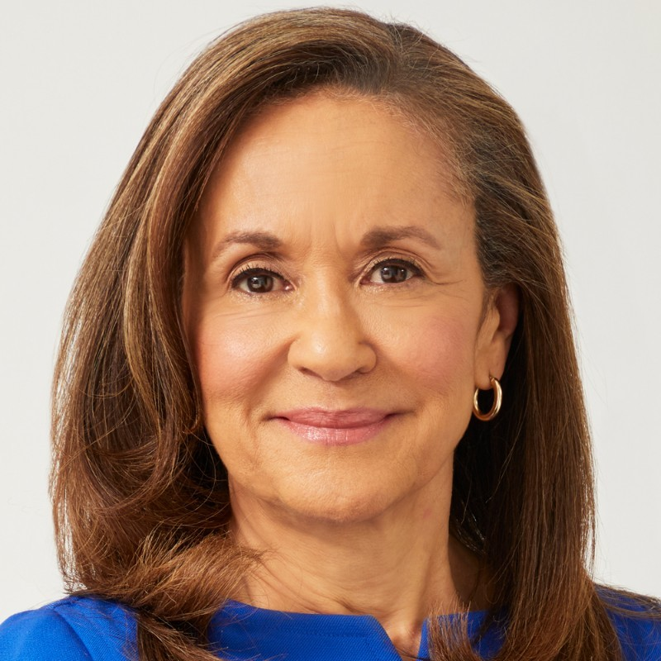
FIRESIDE CHAT
GAYLE KING
American television personality, author and broadcast journalist
GLENDA MCNEAL
President,
Enterprise Strategic Partnerships

Slide 18
2023
EXECUTIVE
BEN
Global Forum

Slide 19
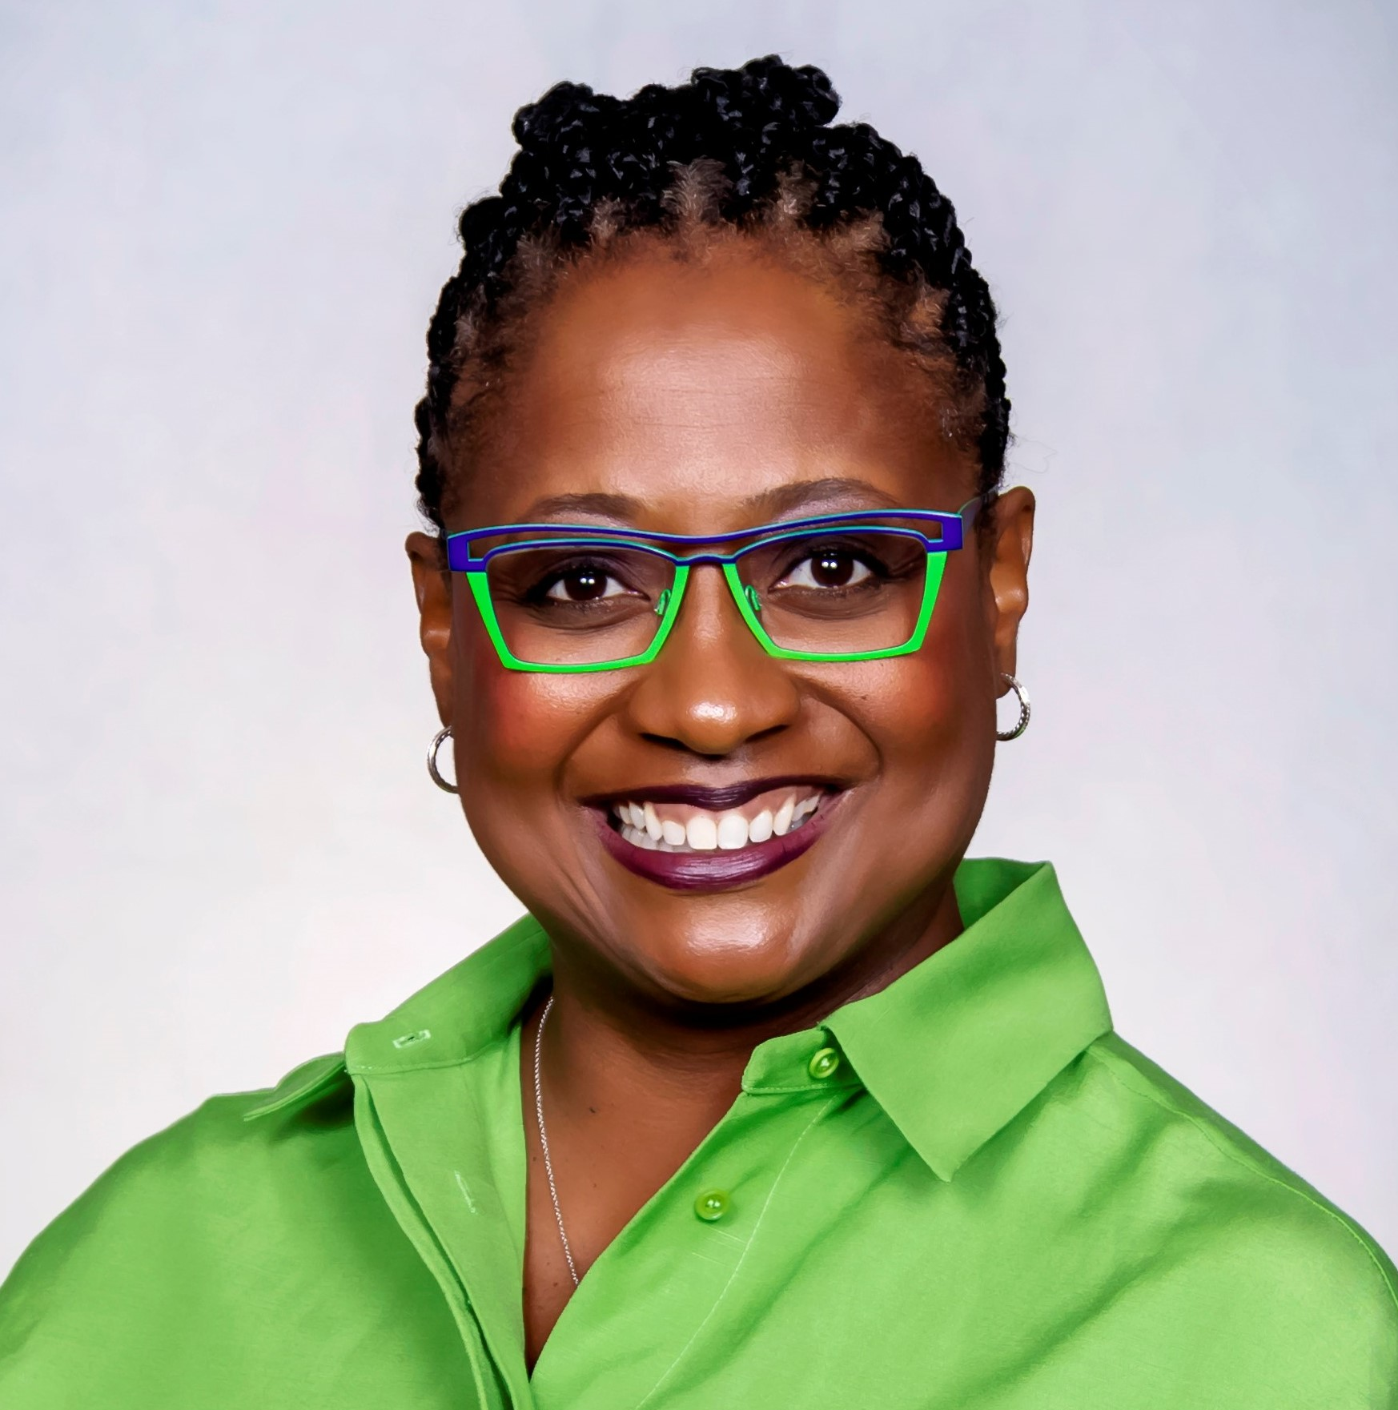
FIRESIDE CHAT
MARVIN ELLISON
Chairman and Chief Executive Officer Lowe’s Companies, Inc,
COLLEEN TAYLOR
President, US Merchant Services

Slide 21
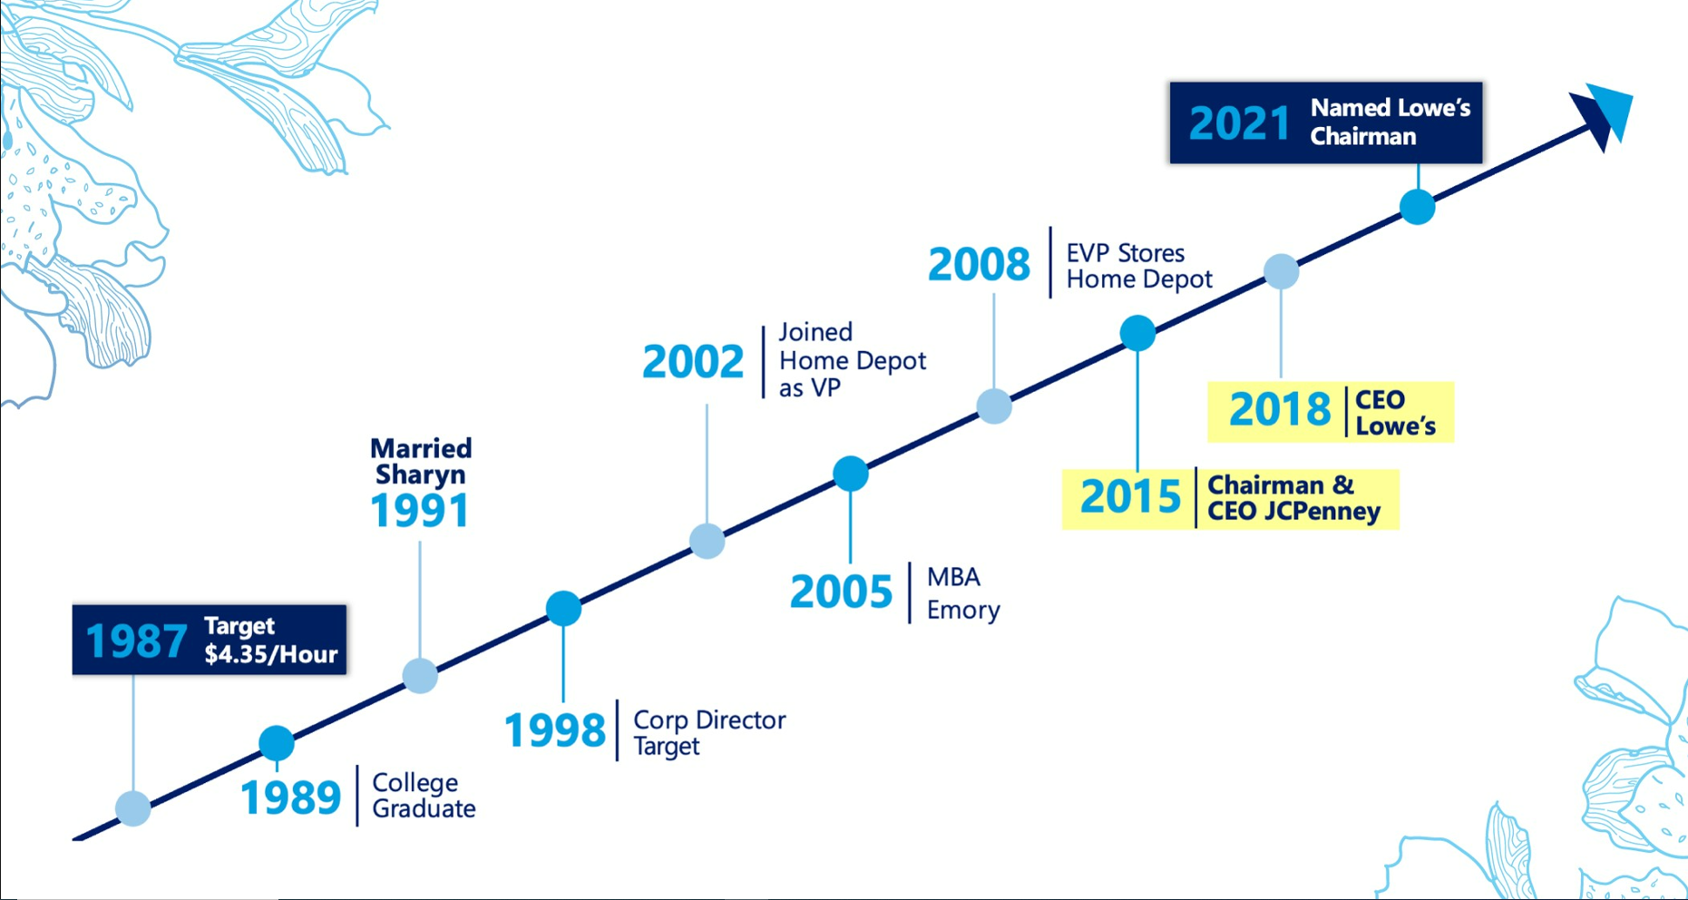

Slide 22
2023
EXECUTIVE
BEN
Global Forum

Slide 23
NETWORKING LUNCH
Rooms 3 & 4
TODAY’S LUNCH IS CATERED BY MELBA’S
Founded by Melba Wilson, Melba’s opened its doors in Harlem in 2005. It has come to be regarded as the premier comfort food destination in New York City.

Slide 24
WORKSHOP
INTRODUCTION
PLEASE REFER TO THE APP FOR WORKSHOP ASSIGNMENT
Room 1: Leading with Authenticity
Room 8A: Navigating Sponsorship Within AXP
Room 9: Leading Through Change: Resiliency

Slide 25
2023
EXECUTIVE
BEN
Global Forum

Slide 26
EXEC BEN
UNPLUGGED
WALTER JACKSON
JAMAL EPPS
SARAH DOBBS-BROWN

Slide 27
EXEC BEN UNPLUGGED
STRATEGIES FOR CAREER TRANSITIONS
WALTER JACKSON
Senior Vice President & Deputy, US Client & Acquisitions

Slide 28
Strategies for Career Transitions
Your career is a journey, and its yours alone. Others may help you navigate, but you must steer the ship.
- Ken Poirot

Slide 29
By The Numbers
14
8
3
3
1

Slide 30
Self-Assessment
Your work is going to fill a large part of your life, and the only way to be truly satisfied is to do what you believe is great work. And the only way to do great work is to love what you do.
- Steve Jobs

Slide 31
Taking Risks
The biggest risk is not taking any risk. In a world that’s changing really quickly, the only strategy that is guaranteed to fail is not taking risks.
- Mark Zuckerberg

Slide 32
Continuous Learning
I have no special talents; I am only passionately curious.
- Albert Einstein

Slide 33
Building Relationships
Business is all about relationships and relationships are built on trust.
- Tom Peters

Slide 34
There Will Be Setbacks
Deserve got nothing to do with it.
Snoop from The Wire

Slide 35
Summary
You must manage your career – be intentional
Know yourself
Take risks
Be intellectual curious and keep growing
Build relationships
Be persistent – there will be setbacks

Slide 36
EXEC BEN UNPLUGGED
Q&A

Slide 37
EXEC BEN UNPLUGGED
NEW TO BLUE AND JUST BEING NEW
JAMAL EPPS
Executive Vice President, Chief Financial Officer, Global Consumer Services

Slide 38
EXEC BEN UNPLUGGED
Q&A

Slide 39
EXEC BEN UNPLUGGED
AUTHENTIC & COURAGEOUS LEADERSHIP
SARAH DOBBS-BROWN
Executive Vice President & Deputy, General Counsel

Slide 40
Authentic leadership: what does it mean as a concept throughout our career?
What is Authenticity?
How you connect with people and allow them to know and connect with you
Ultimately, being vulnerable in this way creates trust
Not just “being yourself” and being rigid to outside information and resistant to change
An environment that encourages us to find commonalities and see the possibilities and opportunities in difference?

Slide 41
A couple of examples – “The Junior Associate”
Not interested in the work? Not engaged? Doesn’t understand? Not invested?
Practice of law is an apprenticeship
Fear of asking a dumb question – afraid of being vulnerable
If people are scared or intimidated from asking questions or speaking up, they miss out on opportunities to learn, but leaders also miss out on the benefit of another smart mind looking at a problem or issue
How do we act like an owner and be actively invested in the outcome
We all feel like the junior associate sometimes

Slide 42
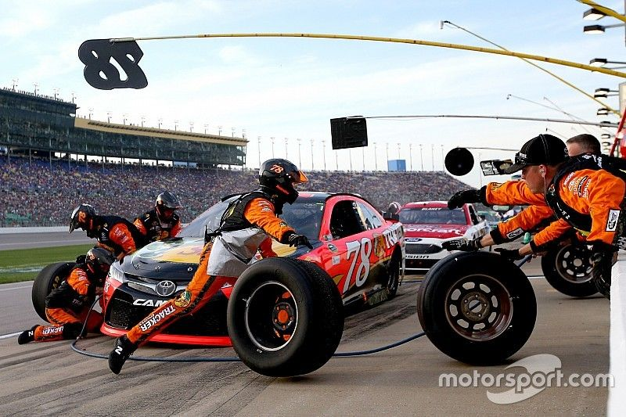
A couple of examples – NASCAR Pit Crew
Choose a job!
Uneasy and conflicted about how responsible I wanted to be for the overall operation
“Easy” role but driving from the peanut gallery
Was I doing this in other contexts at work?
I put myself on the side line. How could I be more invested in the outcome and define my role broadly?
What’s the second order challenge?

Slide 43
EXEC BEN UNPLUGGED
Q&A

Slide 44
2023
EXECUTIVE
BEN
Global Forum

